Slide 1
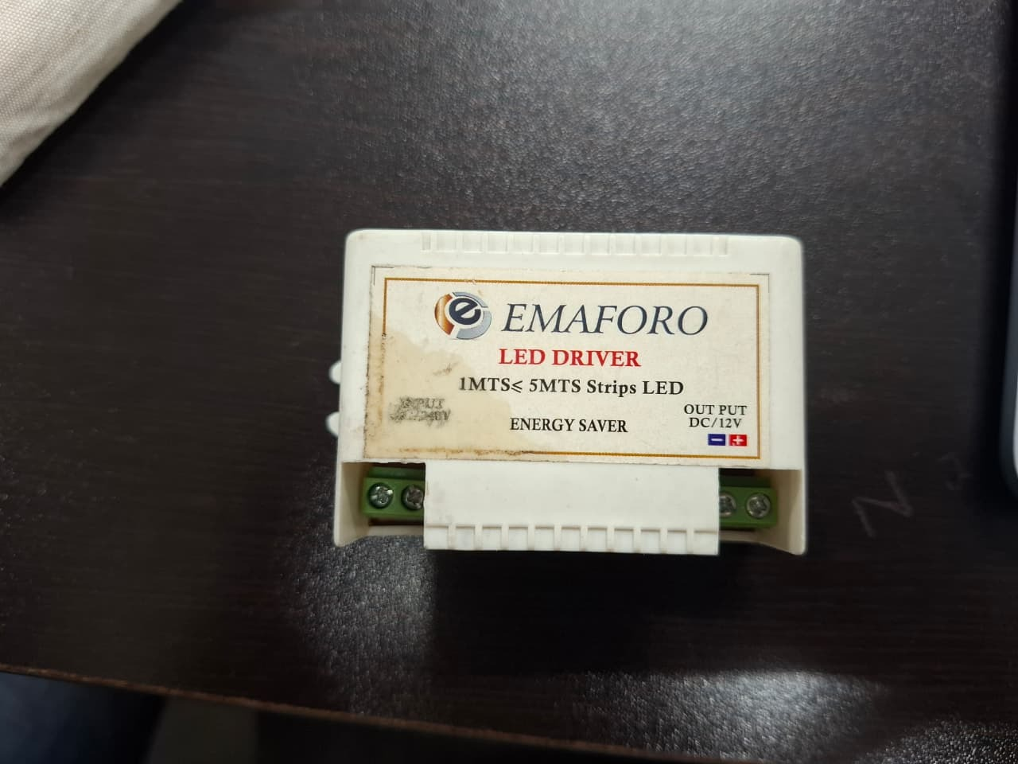
HARDWARE REVERSE ENGINEERING STUDY | POWER ELECTRONICS
EMAFORO 12V DC LED Driver
Evidence-Based Teardown & Circuit Analysis
An exhaustive physical and architectural teardown answering the central engineering question: 'Why was this product designed this way?' Distinguishing verified physical facts from hypotheses.
TARGET PRODUCT
METHODOLOGY
DESIGN REASONING
EMAFORO 12V LED Driver
Strict Evidence Discipline
Cost-Optimized SMPS
Subject Product: As-Received State
• Enclosure: White plastic wall-mount module
• Front Label: 'EMAFORO LED DRIVER'
• Application: 'IMTS <= 5MTS Strips LED'
• Output Rating: 'OUTPUT DC/12V'
• Efficiency Claim: 'ENERGY SAVER' marked
Compact offline AC-to-DC switching converter marked 'EMMS 5MTS LED' and 'ENERGY SAVER' for 12V LED lighting strips.
Rejects hypothetical product generations; grounds every finding in physical photographs, teardown logs, and BOM mapping.
Through-hole single-sided PCB (BMS/999A) with discrete magnetic isolation, balancing low BOM cost and practical field installation.
3-Day Reverse Engineering Framework: Teardown • BOM • Functional Schematics • Engineering Reasoning

Slide 2
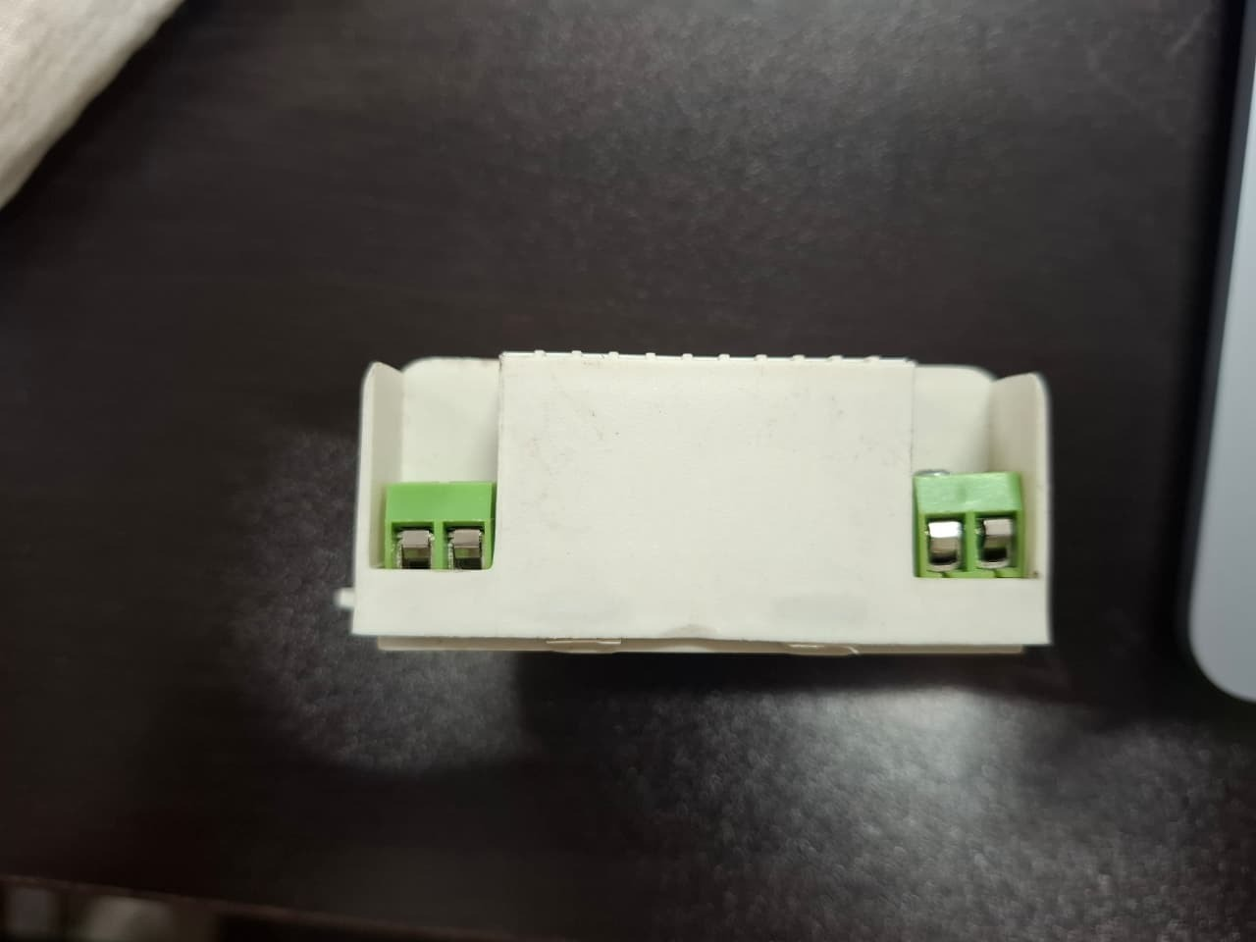
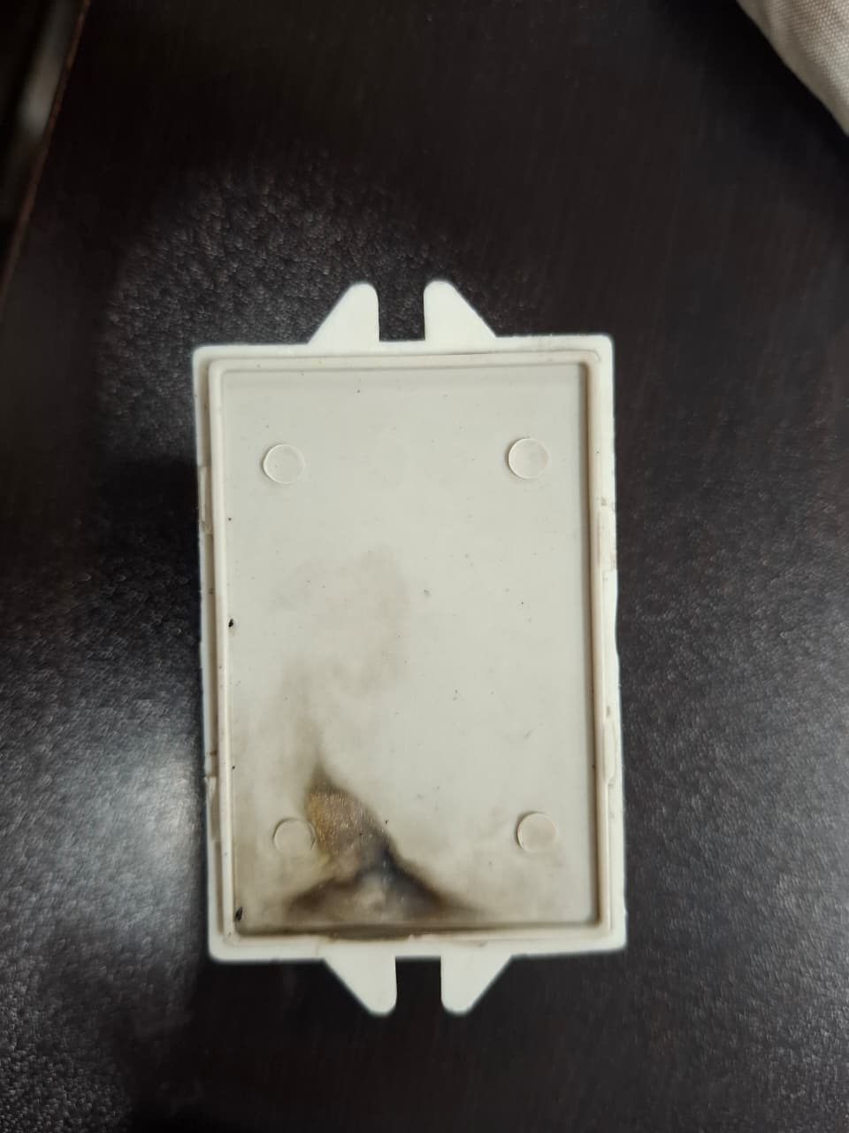
MODULE 1 & PART II | EVIDENCE FRAMEWORK
Physical Inspection & The Evidence vs. Hypothesis Rule
Non-destructive observation and the rejection of undocumented evolutionary claims
External Physical Characteristics
The Evidence-Based Doctrine
Parameter | 6.2*5*3cm
Form Factor | Small rectangular white plastic module with mounting tabs
Connectors | Two green 2-position screw terminals (CN1 input, CN2 output)
User Interface | No external buttons, toggle switches, or LED indicators
Sensors & Data | No USB, data buses, or environmental sensors detected
Thermal Path | Enclosed housing without active ventilation slots
Evidence vs. Hypothesis:
Only what is physically observable in the hardware is recorded as fact. Operating specs (efficiency, current limits, switching frequency) require active bench measurements.
Product Evolution (Part II):
Historical research revealed NO earlier (Gen 1) or subsequent (Gen 2/Latest) models from EMAFORO. The report firmly rejects hypothetical industry upgrades as brand history.
Zero 'Smart' Technologies:
Physical inspection confirms no microcontrollers, RF antennas (Wi-Fi/BLE), or DALI digital lighting buses exist on the board.
User Expectation:
Stable 12V DC delivery, continuous LED operation, safe galvanic isolation, and easy field screw-terminal wiring at low unit cost.
Green 2-position screw terminals for AC input and 12V DC output
Rear casing plate showing mounting tabs and internal cavity

Slide 3
MODULE 4 & 5 | GUIDED TEARDOWN & SAFETY
Systematic Teardown Sequence & Electrical Safety Protocols
Controlled non-destructive disassembly, stored energy hazards, and ESD protection
6-Step Teardown Sequence
High-Voltage Safety Protocols
Step 1: Document
Record external markings, labels ('EMMS 5MTS LED', 12V), and physical dimensions before unsealing.
Step 2: Photograph
Baseline multi-angle photographs of enclosure, screw terminals, and mechanical seams.
Step 3: Open Enclosure
Non-destructive separation using precision pry tools along the casing seam.
Step 4: Photograph Internals
High-resolution photos of PCB component side and bottom copper solder tracks.
Step 5: Component ID
Catalog designators (T1, Q1, D1-D7, C1-C5) and inspect semiconductor markings.
Step 6: Record & Map
Assemble BOM table and trace interconnects to synthesize functional schematic.
DANGER: Offline Mains Power
The PCB connects directly to AC mains. Disassembly or physical probing while connected to AC line is strictly prohibited.
WARNING: Capacitor Stored Charge
The large bulk electrolytic capacitor (C1) retains lethal DC voltage (>300V rectified mains) long after AC power is removed. Mandatory meter discharge check.
CAUTION: Galvanic Isolation
Do not assume output is safe (SELV) purely because it is labeled 12V. Verify physical creepage distances and transformer insulation before testing.

Slide 4
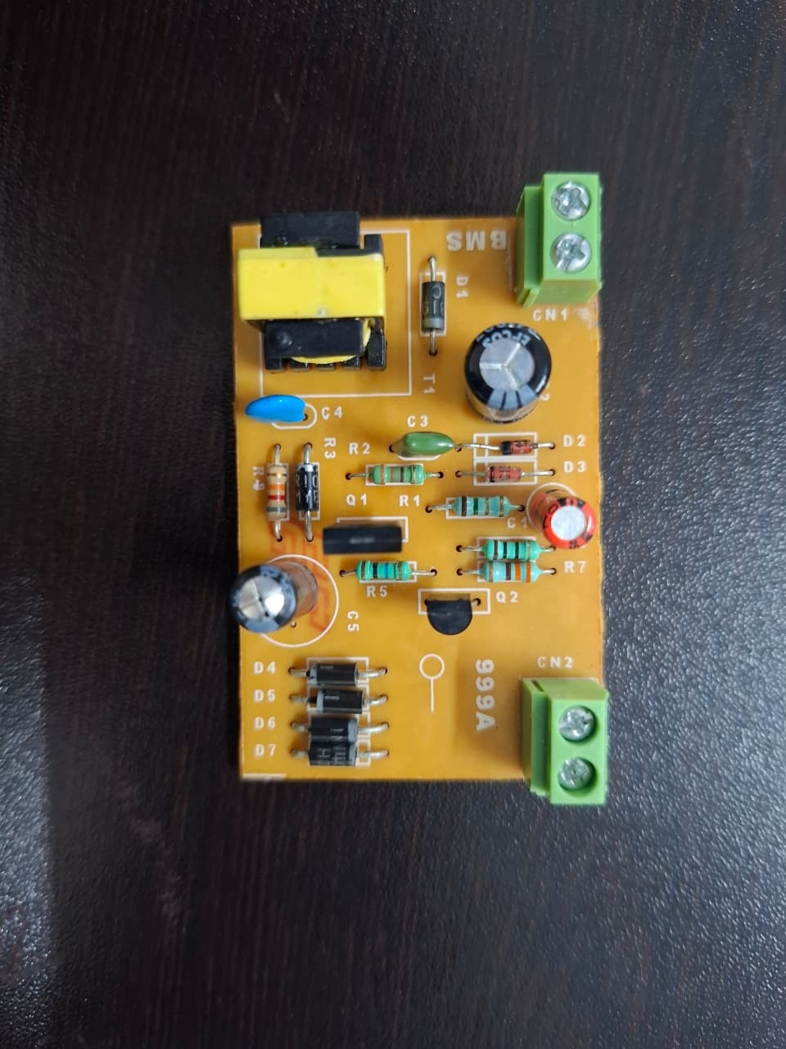
MODULE 6 | HARDWARE TEARDOWN & BOM
Internal Hardware Analysis & Bill of Materials (BOM)
Physical inventory of single-sided PCB (marked BMS / 999A) and component functional roles
Component Inventory & Functional Roles
Ref. | Component | Package | Observed Role & Circuit Connection
T1 | HF Transformer | Through-Hole EE/EF | Galvanic isolation; magnetic energy transfer across primary & secondary
D1–D7 | Rectifier Diodes | Axial Lead Through-Hole | Mains bridge rectification, primary snubber clamping, & secondary 12V output
Q1 / Q2 | Switching Transistors | Through-Hole TO-92/126 | SMPS primary high-frequency chopper & oscillator control circuitry
C1 / C5 | Electrolytic Caps | Radial Through-Hole | C1: High-voltage rectified bulk storage; C5: Low-ESR 12V output filter
R1–R7 | Resistor Network | Axial Lead Through-Hole | Startup bias, primary current sensing, control feedback, and snubber damping
C3 / C4 | Film/Ceramic Caps | Through-Hole | High-frequency switching spike suppression, snubber timing, and EMI filter
CN1/2 | Screw Terminals | 2-Pos Green Terminal | External field connections (CN1: AC Mains input; CN2: 12V DC LED output)
PCB Top View (BMS / 999A Marking)
Through-hole construction with high-frequency transformer T1, bulk electrolytic capacitors, discrete rectifiers, and green terminals.

Slide 5
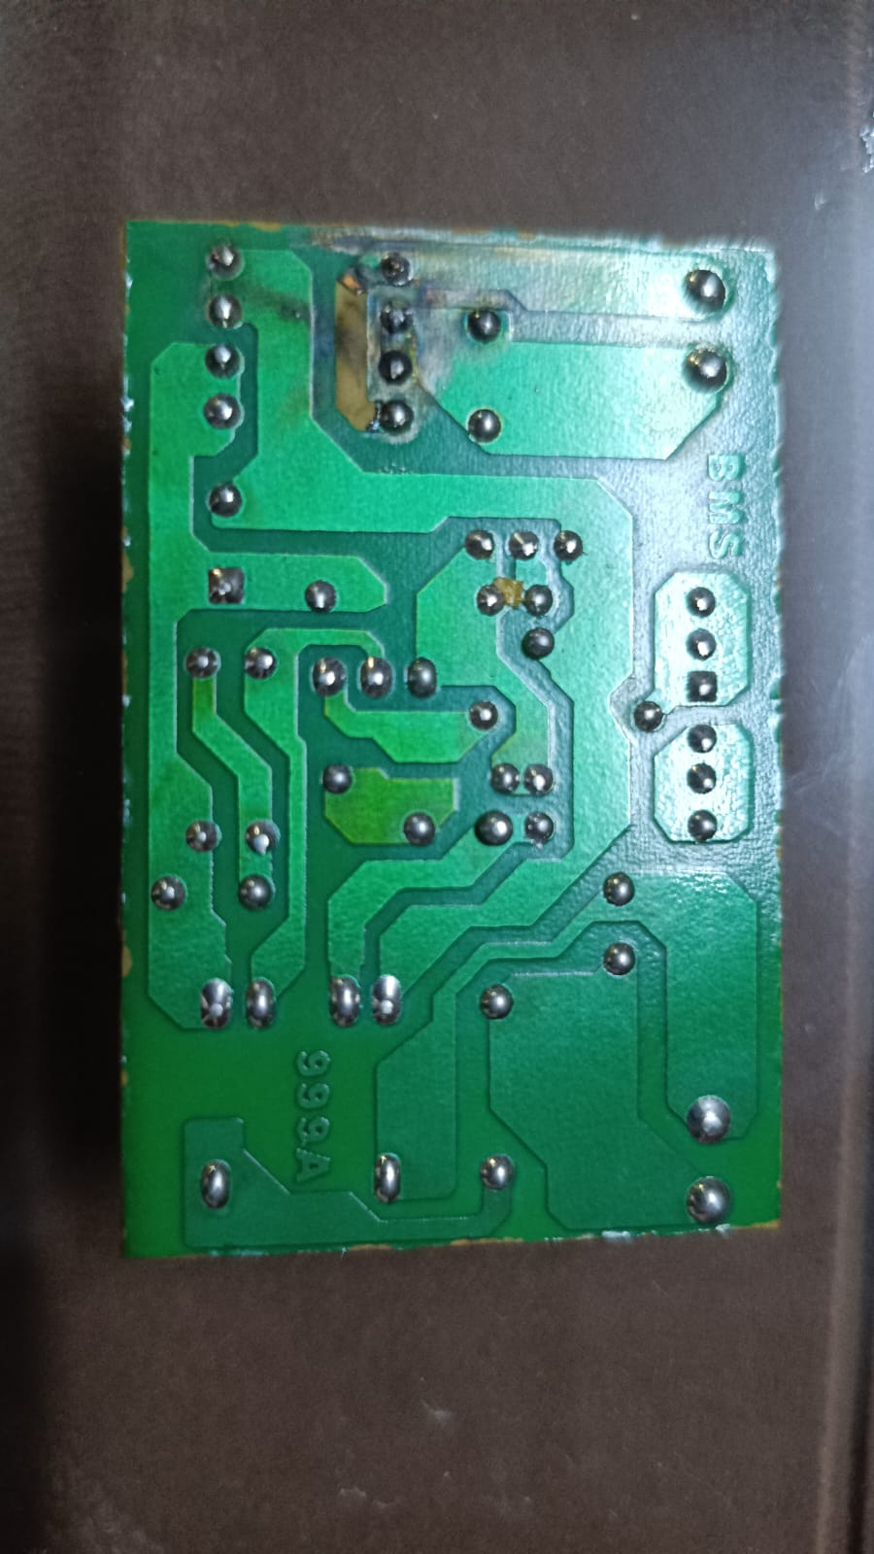
MODULE 7 | CIRCUIT TOPOLOGY & OPERATIONS
Functional Block Diagram & Power Conversion Flow
Tracing electrical energy conversion from mains AC input to isolated 12V DC output
1. AC Mains
Terminal CN1
85–265V AC input from building line
2. Bridge Rectifier
Diodes D1–D4
Converts AC to pulsating high-voltage DC
3. Bulk DC Filter
Capacitor C1
Smooths DC rail to ~300V reservoir
4. HF Switching
Transistors Q1/Q2
Chops DC at high frequency (tens of kHz)
5. Isolation Trans.
Transformer T1
Galvanic barrier & magnetic energy transfer
6. Sec. Rectifier
Diodes D5–D7
Rectifies high-frequency secondary pulses
7. Output Filter
Capacitor C5
Smooths ripple to stable 12V DC
8. 12V LED Load
Terminal CN2
Powers LED lighting strip (up to 5m)
SMPS Working Principle & Architecture Insights
• Why SMPS(Switched mode power supply) over Linear Regulation?
Operating at high switching frequency (tens of kHz) enables a miniature ferrite transformer (T1) instead of a heavy, bulky 50/60 Hz mains iron core, reducing weight, enclosure size, and copper costs.
• Galvanic Safety Isolation:
The transformer core and primary-secondary board spacing form the physical safety barrier protecting the low-voltage 12V output from dangerous AC mains voltages.
• No Digital / Smart Overhead:
Confirmed absence of microcontrollers, Bluetooth/Wi-Fi modules, or DALI protocols. It is a dedicated, self-contained AC-to-DC power converter.
PCB Solder / Track Side: Single-sided copper traces with visible primary-secondary creepage separation.

Slide 6
CONCLUSIONS & LEVEL 5 REASONING
Engineering Trade-Offs, 5 Levels of Thinking, & Next Steps
Uncovering designer compromises, applying cognitive levels, and defining quantitative test plans
Key Engineering Trade-offs
The 5 Levels of Thinking
Laboratory Test Roadmap
Cost vs. Advanced Protection
A discrete through-hole design keeps bill-of-materials and manufacturing costs minimal, but lacks sophisticated active PFC, over-voltage latching, and digital diagnostics found in industrial drivers.
Form Factor vs. Thermals
A compact unvented plastic enclosure shields users from shock and fits easily in tight spaces, but limits natural convective heat dissipation under high ambient loads.
Through-Hole vs. SMD Density
Using through-hole components allows simpler single-sided wave soldering and lower PCB fabrication costs, accepting larger board area than modern SMD assemblies.
Efficiency Claims vs. Reality
The 'ENERGY SAVER' label reflects marketing positioning; true electrical efficiency requires quantitative wattmeter benchmarking.
Level 1: Observation
White plastic casing, green screw terminals, transformer, capacitors, resistors, and diodes.
Level 2: Identification
Segregating board into input, switching, isolation transformer, and output filter stages.
Level 3: Specification
Enclosure label establishes 12V DC output for 5m LED strips; current rating unstated.
Level 4: Functional Understanding
Converts mains AC into high-frequency pulses through magnetic core to deliver smooth DC.
Level 5: Engineering Reasoning
THE CORE GOAL: Deciphering designer compromises across unit cost, safety isolation, thermal limits, and high-volume production.
1. Part Markings & Decapping
Magnified optical inspection or decapping of Q1/Q2 and D1-D7 to confirm exact silicon part numbers and datasheets.
2. Schematic Netlist Tracing
Underside copper continuity probing to draft an exact SPICE/KiCad schematic netlist and feedback loop.
3. Oscilloscope Waveform Probing
Measure primary switching frequency, drain/collector ringing, snubber damping, and secondary output voltage ripple.
4. Load Bench Characterization
Test with 1m–5m 12V LED strips under electronic DC load to measure efficiency (%), voltage droop, and thermal heat rise.

